Slide 1

GRAPH ALGORITHMS · CS 201
Dijkstra's Algorithm
A Greedy Approach to Single-Source Shortest Paths
PROBLEM CLASS
DESIGN PARADIGM
CORE ASSUMPTION
Single-Source Shortest Path
Greedy Strategy
Non-Negative Weights
Locally optimal choices yield a globally optimal path tree.
One origin node to all reachable destinations in a weighted graph.
Every edge weight ensures once-finalized distances stay optimal.
Notes:
Welcome to our deep dive on Dijkstra's algorithm. Today we study how a greedy strategy solves the single-source shortest path problem efficiently on graphs with non-negative edge weights.

Slide 2
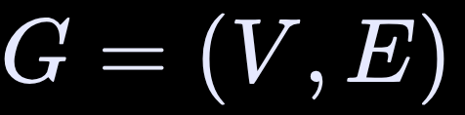
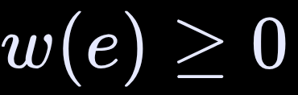


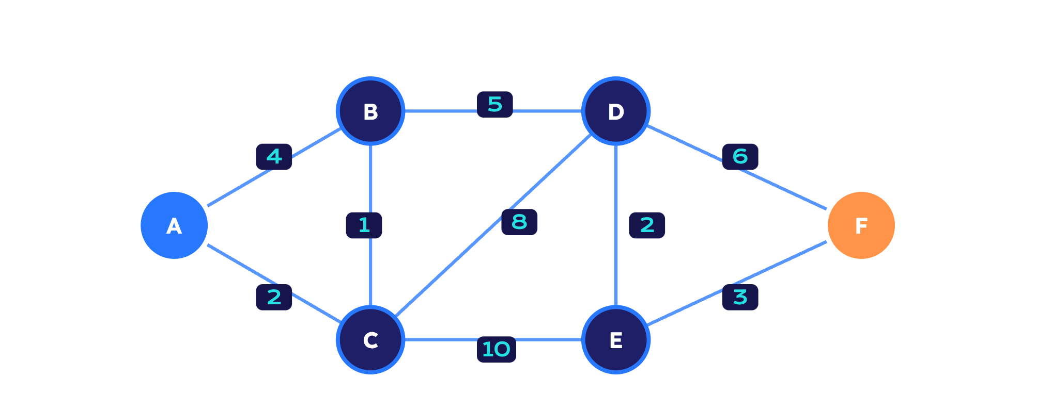
THE OBJECTIVE
The problem: shortest paths from one source
Given a directed or undirected weighted graph with edge weights , find the minimum-total-weight path from source node to destination .
CANONICAL EXAMPLE GRAPH
Source vertex: A (Origin); path distance initialized to 0.
Target vertex: F (Destination).
Graph: 6 vertices, 9 undirected edges. Non-negative weights guarantee greedy correctness.
Notes:
Our goal is to compute the minimum-cost route between the source vertex A and destination vertex F. Notice how edge weights represent latency, distance, or cost, all strictly non-negative.

Slide 3
ALGORITHM OVERVIEW
Dijkstra finds the cheapest route to every reachable node
HISTORICAL ORIGIN
REQUIRED INPUT
Edsger W. Dijkstra
A weighted graph with non-negative edge weights and one source.
Dutch computer scientist; conceived the algorithm in 1956. Designed it in about 20 minutes, without pencil and paper, to demonstrate the ARMAC computer’s capabilities.
COMPUTED OUTPUT
Minimum distance from the source to every reachable node.
Even when targeting destination F, Dijkstra computes optimal shortest distances to all intermediate vertices as a natural byproduct.
Notes:
Dijkstra designed this algorithm to showcase the power of greedy choices. Remember that even if you only need the route to F, Dijkstra calculates the shortest path from the source to every reachable node.

Slide 4





GREEDY INVARIANT
Greedy choice: finalize the closest unvisited node
Maintain the settled/explored boundary; lock in the minimum candidate.
1. Select Min Distance
2. Finalize & Settle
3. Relax Neighbors
Choose unvisited with minimum tentative .
Settle permanently; positive edge weights mean no shorter future path.
Relax outgoing edges from , updating neighbors; repeat until the queue is empty.
Why this greedy choice is provably optimal: Any alternate route passes through unvisited nodes with equal-or-greater tentative distances; non-negative edges only increase path cost.
Notes:
At each step, we pick the unvisited node with the smallest distance. Because edge weights cannot be negative, this node can never be reached through a shorter indirect path later, making our choice permanently final.

Slide 5


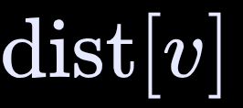






EDGE RELAXATION
Relaxation: update a neighbor when a shorter path appears
Relaxation is the arithmetic update: if traveling through reaches faster than its current record, lower .
FORMAL CONDITION
VISUAL COMPARISON: EDGE (C, B)
If , set .
BEFORE VISITING C (DIRECT FROM A)
Path A → B (Weight: 4); dist[B] = 4
Direct edge : 4. Via : .
AFTER RELAXING FROM C (A → C → B)
updates from 4 to 3.
Path A → C (2) + Edge C → B (1) = 3; dist[B] = 3
The predecessor pointer updates to to reconstruct the shortest path.
Notes:
Relaxation tests whether routing through our current node improves the best known distance to a neighbor. Here, reaching B through C costs only 3, beating the direct edge from A which costs 4.

Slide 6
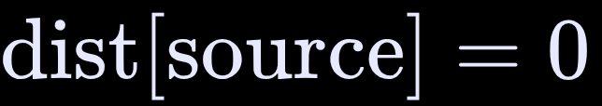
INITIALIZATION STATE
Setup: source at 0, everything else at infinity
Initialize all distances to ∞; set ; enqueue the source.
DISTANCE ARRAY AT T = 0
PRIORITY QUEUE & ADJACENCY
Node | dist[v]
A (Source) | 0
B | ∞
C | ∞
D | ∞
E | ∞
F (Target) | ∞
MIN-PRIORITY QUEUE
Q = { (A, 0) }
Ordered by tentative distance; A is first.
INCIDENT EDGES FROM A
A–B: 4 · A–C: 2
PREDECESSOR ARRAY π
π[v] = null for every v ∈ V.
Notes:
We begin by setting the source node A to zero and all other vertices to infinity. The priority queue initially contains only A, which will be our first extracted minimum.

Slide 7
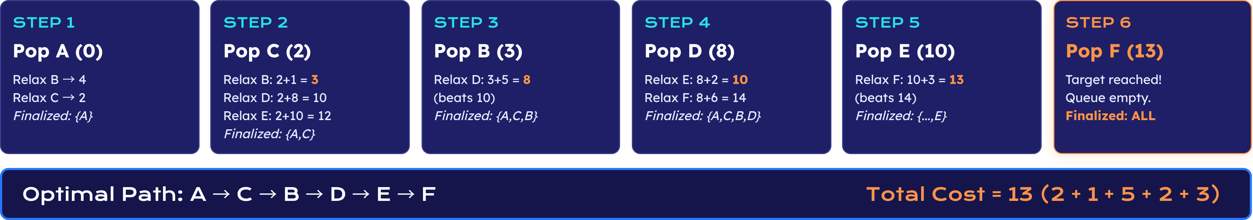
STEP-BY-STEP TRACE
Iterations: select, relax, finalize
Tracing our graph across all six iterations until node F is permanently finalized at distance 13.
Notes:
Follow the sequence of node extractions: A, C, B, D, E, and finally F. Note how relaxing C lowers B to 3, and later relaxing E reduces F from 14 down to 13, establishing the optimal path.

Slide 8

IMPLEMENTATION DETAILS
Pseudocode and the data structures behind it
An efficient Dijkstra implementation relies on synergistic data structures to achieve fast lookup and priority extraction.
ALGORITHM PSEUDOCODE
Adjacency List
def dijkstra(graph, source):
dist = {v: float('inf') for v in graph}
dist[source] = 0
pq = [(0, source)] # min-heap priority queue
visited = set()
while pq:
d, u = heapq.heappop(pq)
if u in visited:
continue
visited.add(u)
for v, weight in graph[u].items():
if v not in visited:
new_d = dist[u] + weight
if new_d < dist[v]:
dist[v] = new_d
heapq.heappush(pq, (new_d, v))
return dist
Stores vertex neighbors and edge weights with space .
Distance Map & Visited Set
Tracks best tentative distances and prevents reprocessing finalized nodes.
Notes:
The pseudocode pairs an adjacency list with a binary min-heap. Notice the check to skip already visited vertices when duplicate entries exist in the priority queue.

Slide 9
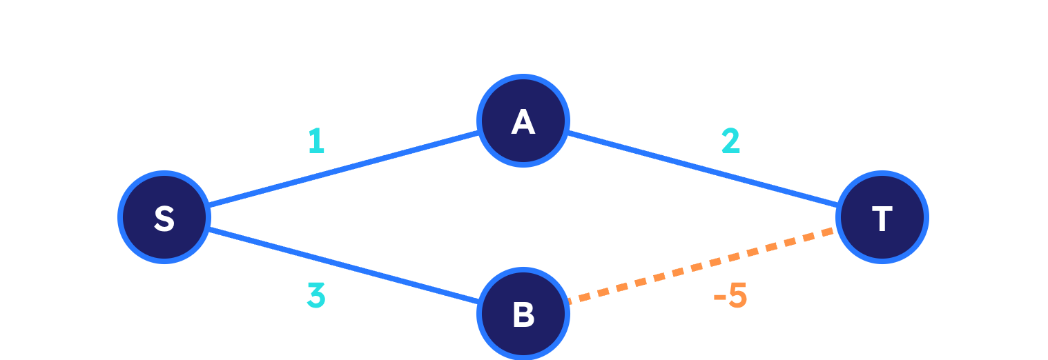




PERFORMANCE & CONSTRAINTS
Complexity and limitations
Asymptotically optimal for positive graphs; negative edge weights break the greedy assumption.
ASYMPTOTIC BOUNDS
CRITICAL FAILURE: NEGATIVE EDGES
O((V + E) log V)
Time with a binary min-heap; commonly O(E log V) on connected graphs.
O(V)
Greedy minimum extraction finalizes via (cost 3), then never re-checks (cost -2). Use Bellman-Ford for negative weights.
Auxiliary space: priority queue, distance array, and visited set.
A Fibonacci heap improves theoretical time to ; practical overhead usually favors standard binary heaps.
Notes:
Binary heap implementations run in O(E log V) time. Emphasize that negative edges invalidate Dijkstra: once a node is finalized, the greedy choice never reconsiders it, potentially missing cheaper paths with negative values.

Slide 10




SUMMARY & REAL-WORLD IMPACT
Where it is used, and what to remember
Applications
What to remember
TAKEAWAY 1 · Greedy choice: Permanently finalize the closest unvisited node.
TAKEAWAY 2 · Relaxation: Iteratively update neighbor distances whenever shorter routes appear.
TAKEAWAY 3 · Weight constraint: Weights must be non-negative; otherwise choose Bellman-Ford.
GPS and navigation: Turn-by-turn navigation engines calculate fastest drive times.
Network routing: OSPF and IS-IS route IP packets across the internet.
Robotics: Collision-free motion planning across mapped obstacle grids.
Game pathfinding: Pathfinding heuristics; foundational precursor to A* search.
Based on an introductory lesson on Dijkstra's Algorithm.
Notes:
To summarize: Dijkstra relies on greedy selection, iterative relaxation, and non-negative edge weights. It remains the foundation of modern map routing and internet packet switching protocols today.

